Slide 1
A second introduction to F.S.
Plan
1.《 Introduction to variables and feature selection》
- Background knowledge of F.S.
2.《 Causal feature selection algorithm for……》
- A new example of F.S.

Slide 2
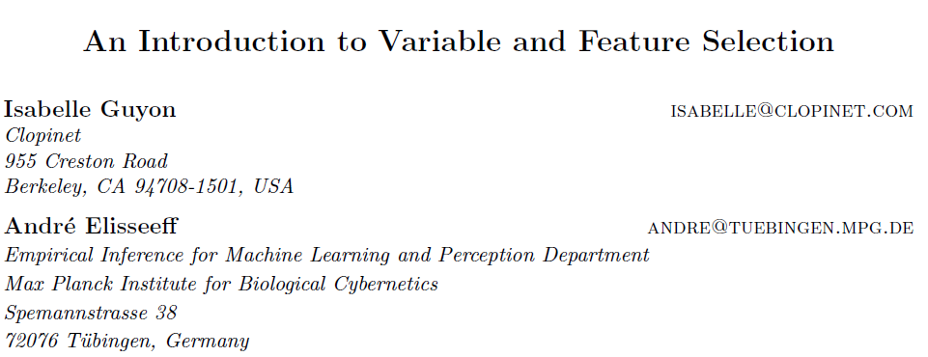
Brief intro of history :
- 90s : few domains > 40 features
- After 2000 : 100 – 10,000
Irrelevant and redundant variables

Slide 3
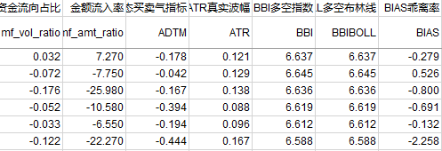
Feature subset
Stock feature
Data = {(Xi, Yi)}
Dim(Xi) = (num_pre_days × num_stock_features, 1)
Dim(Yi) = (1,1) %close price%
Input feature

Slide 4
Different perspective
A first point of view
F.S.
Original data
Feature construction
A | B | C
a1 | b1 | c1
a2 | b2 | c2
… | … | …
D(A,B)
d1
d2
…
e.g PCA…

Slide 5
A second point of view
“Good” features
“Bad” features
F.S.
Filter
Wrapper
Embedded method
Score ranking : S(X1) > S(X3) > S(X2)…
Suboptimal
( Criteria : correlation, mutual info…)
For one certain
learning machine
optimal

Slide 6
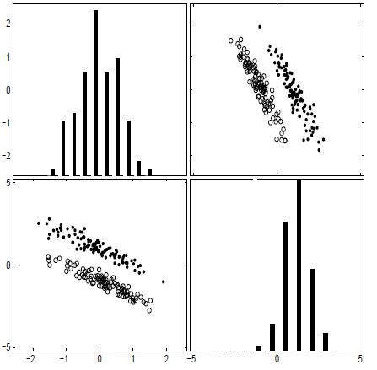
A simple explanation
Score ranking :
S(X1) > S(X3) > S(X2) > S(X4) …
2 “bad” fs = “good”
Explanation

Slide 7
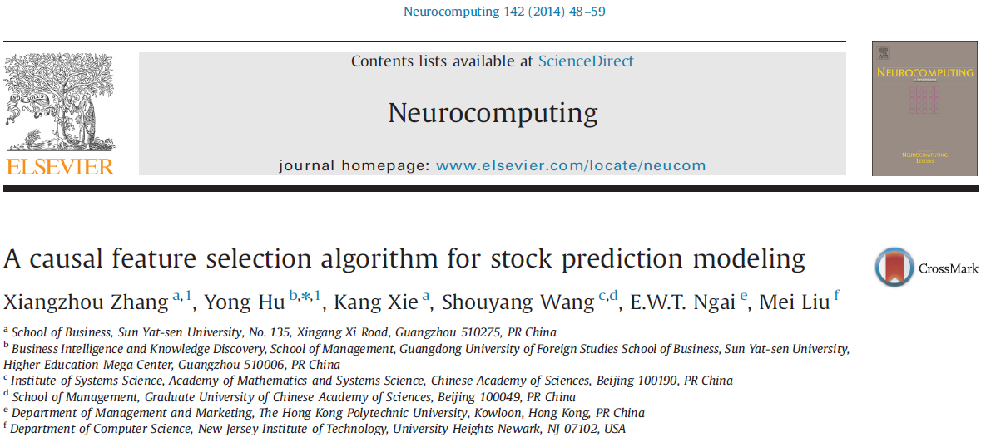
Objective :

Slide 8
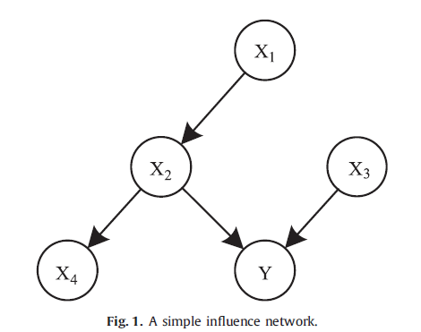
Inspiration : Causal inference(J.Pearl)
Correlated
Causal
Xa → Y → Xb
Xa ← Y → Xb
(Xa,Xb) conditionally independent given Y
Xa → Y ← Xb
(Xa,Xb) conditionally independent not given Y

Slide 9
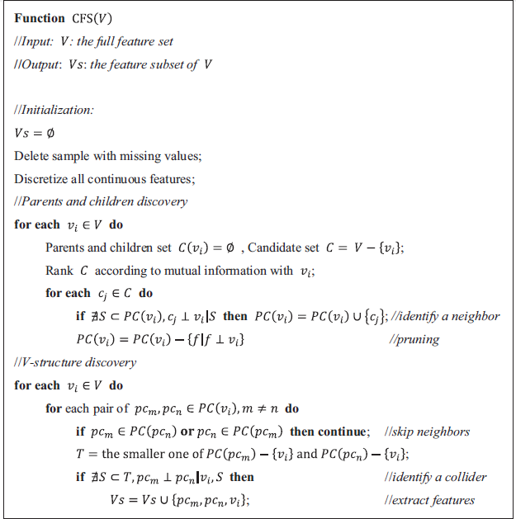
(Several V-structures)
CFS Algo
Step 1
Initialization
Step 2
PC set
(potential features)
Step 3
V-structure discovery

Slide 10
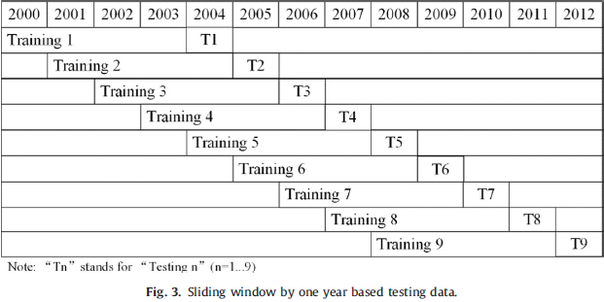
Experiments
13-year-long data : Training / Testing

Slide 11
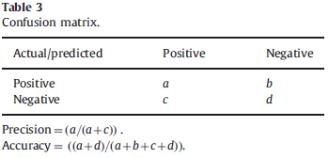
Prediction performance

Slide 12
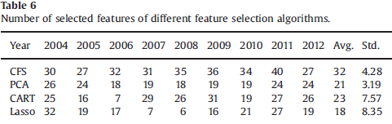
Results - 0
Num_fs_selected : CFS most

Slide 13
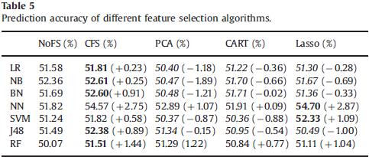
Results - 1
Accuracy : (Not satisfying…)
Mainly based on correlation
Logistic regression
Naïve Bayes
Bayes Net
MLP
SVM
DT
Random forest
Filter method < wrapper

Slide 14
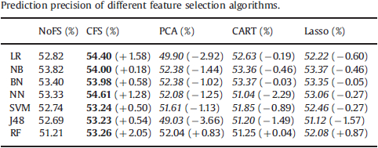
Results - 2
Precision : something phenomenal
Precision or accuracy?

Slide 15
Natural learning performance
Investment/profitability performance
Theoretically……

Slide 16
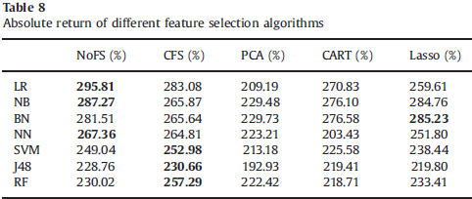
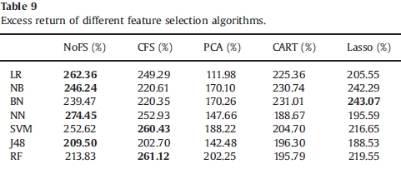
Results - 3
E.R = Real Assets – Expected Assets

Slide 17
Conclusion
CFS (Causal feature selection)
Good filter method
- Accuracy
- Precision ( phenomenal )
It’s stable and robust (see table 9)
Only among filter methods
- no comparison with wrapper methods
Compared with other
Correlation based F.S.

Slide 18
Let’s call it a day !

